Slide 1
Chalk Walk 2023
Tuesday, May 23rd
8:30-12:30
Volunteer training Powerpoint
Theme: books with Caldecott awards

Slide 2
Thank you!!!!
Wolf Canyon Elementary would like to say "thank you" for volunteering your time to help with this special event.
We cannot do this event without our volunteers.

Slide 3
Purpose
All students will have the opportunity to engage in rich artistic experiences while working with peers
Students will make connections with the text selected
Chalk Walk brings the school community together through Visual Arts

Slide 4
The picture
Pictures were selected by the Chalk Walk Committee
Pictures will be outlined the day before on May 22nd.

Slide 5
Materials
The following materials will be provided to you:
A box of chalk
A gridded picture
Rotation schedule
Blue painter’s tape, butcher paper, and a spray bottle
Brushes
Baby wipes (for cleaning hands)
If you have the following items, bring them with you:
    handheld vacuum or shop vac (label with your name)
    extension cords/power strips (label with your name)

Slide 6
Prepare for the day
Wear comfortable, old clothes
Bring sunscreen, hat, knee pads/towels for kneeling, foldable chair
Chalk Walk Day:
When you arrive, check in at the welcome table and collect your supplies
Go to your assigned square and use the butcher paper and tape to mask square on the concrete.

Slide 7
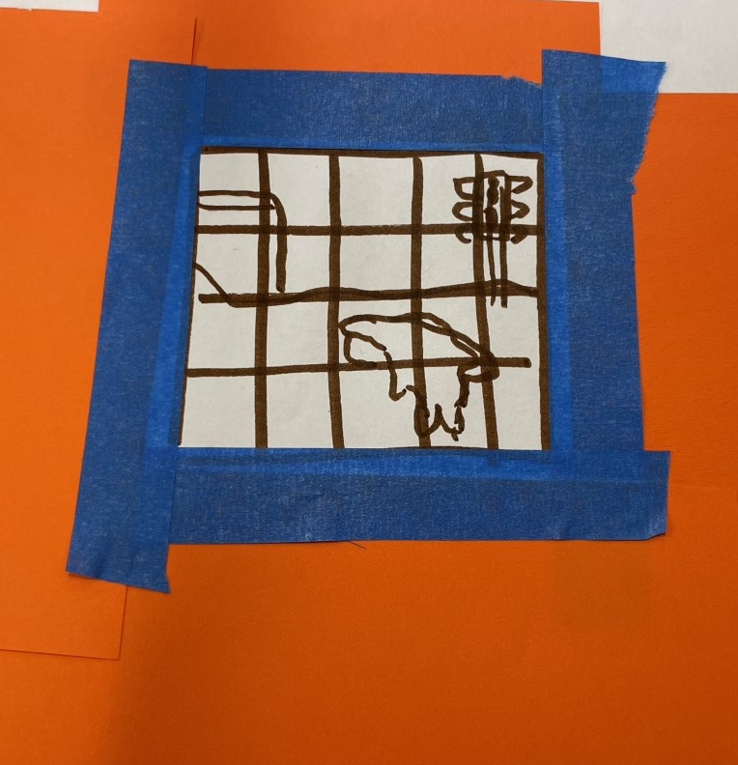
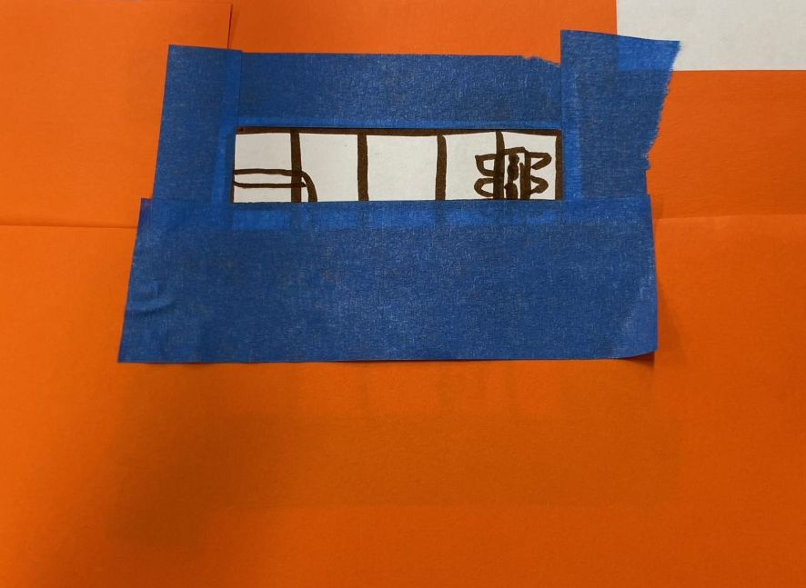
How to mask
(imagine the example is on the concrete)
Use blue tape and butcher paper and
mask the border of your grid.
Leave the first row uncovered and mask the other rows.
Each time a row is complete, mask it. This prevents the art from getting smudged when kids are coloring.
Butcher paper
Row 1 leave
uncovered

Slide 8
Schedule
* indicates New changes
Each class will have a schedule. Please be on time to pick up students. If they need to stay a little longer to finish their square, they can.
Each student will be assigned a square. The primary classes will have 24 squares, and the upper grade classes will have 30 squares.
Each student is responsible for coloring in their assigned square.
A square will typically have 1-2 colors. So, it should be quick.
The rotations are 10 minutes long
All the art is anticipated to be completed by 12:00

Slide 9
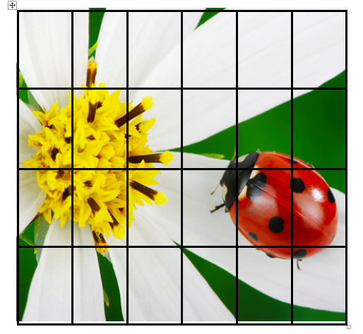
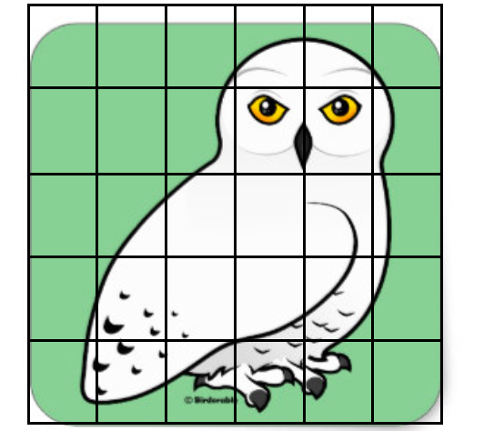
Primary Grid Upper Grade Grid
(24 squares) (30 Squares)

Slide 10
Coloring the picture
As students arrive, let them know what box they will be coloring and what color(s) they will be using
They can use their fingertips to rub the color in
Vacuum the chalk dust frequently
Once students are done, walk them back to class.
Save the outlining for the end (use the black chalk for this)

Slide 11
Monitor your team
It is important that all kids are involved and working
If you have problems, please notify Mrs. Adamos or the classroom teacher
Mrs. Adamos will be available during the entire event to help

Slide 12
Finishing Touches
Touch up areas
Outline everything with black chalk
Tape picture to the right of the mural
Do not add extra borders or words around the concrete square
Before you remove butcher paper around the mural, dust/vacuum the area well

Slide 13
Clean-up
Through away all paper in the trash
Take canopy down (return canopies to the grass area by the front gate)
Return all materials to the welcome table

Slide 14
Lunch time
Make to sure to take a lunch break. PTA will be provided lunch and refreshments

Slide 15
Parade time
We hope you can stay!
Students will be coming out to view all the Chalk Walk art
Chalk Walk Parade
TK-1 1:30-1:45
2-4 1:45-2:00
5-6 2:00-2:20

Slide 16
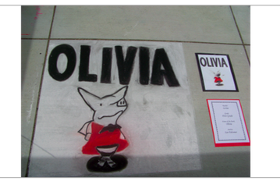
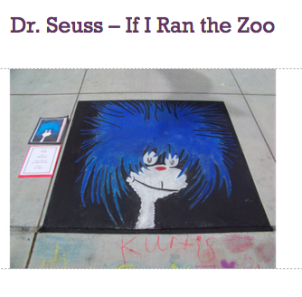
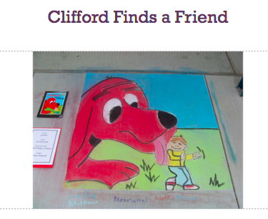

Slide 17
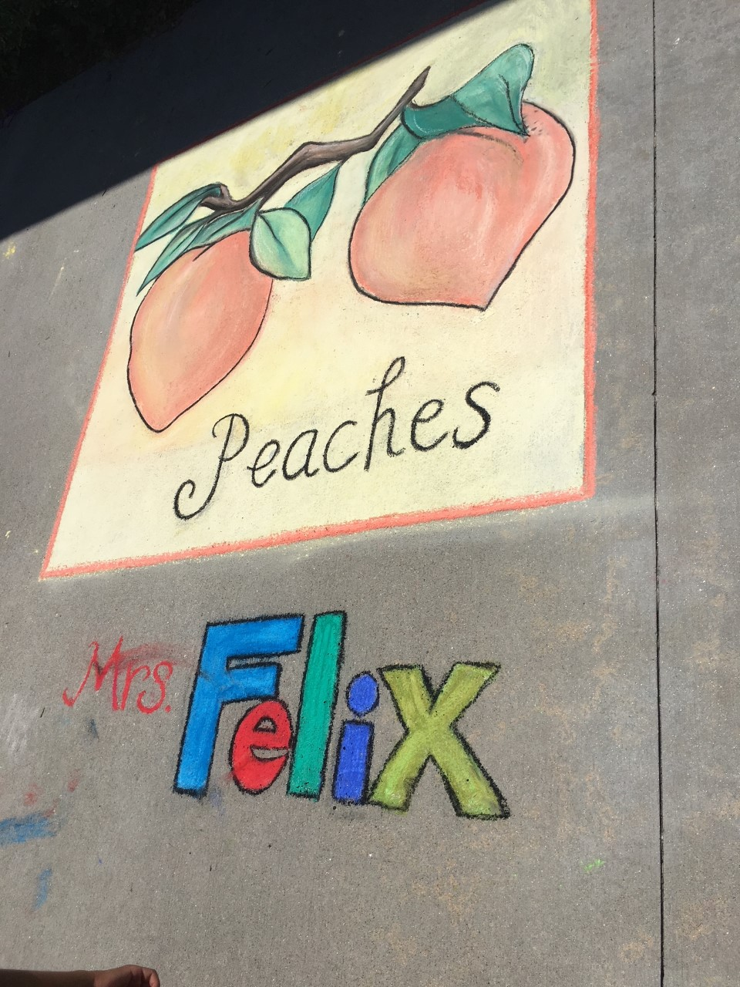
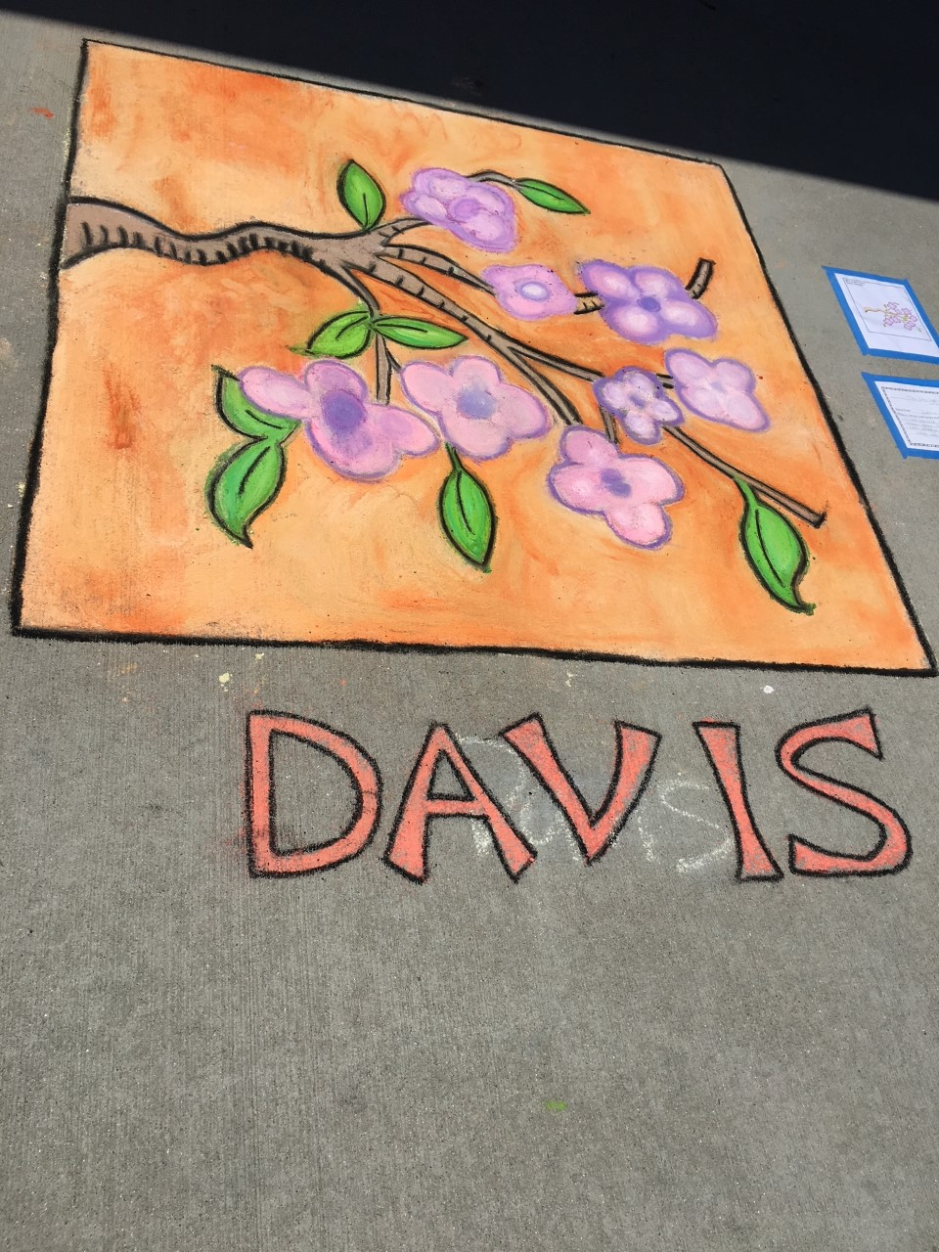
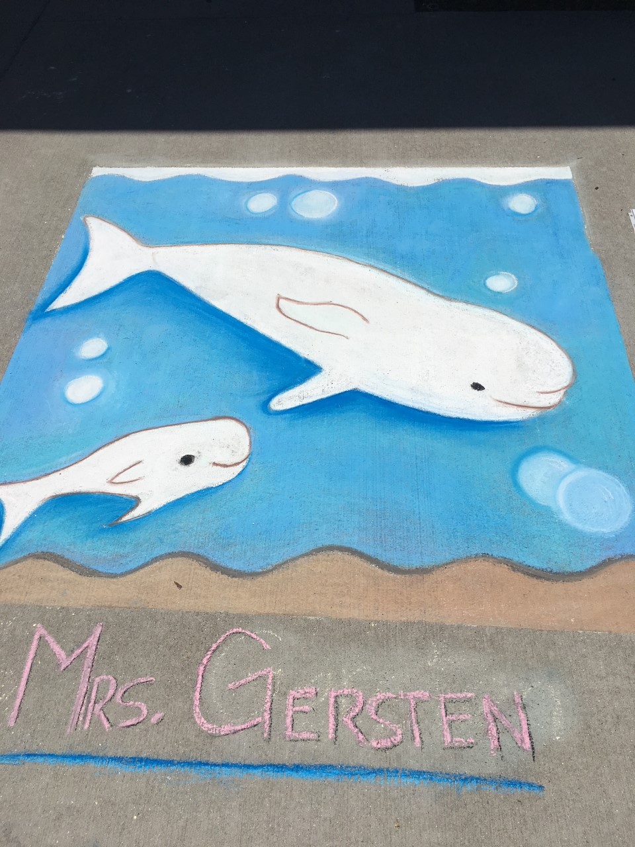
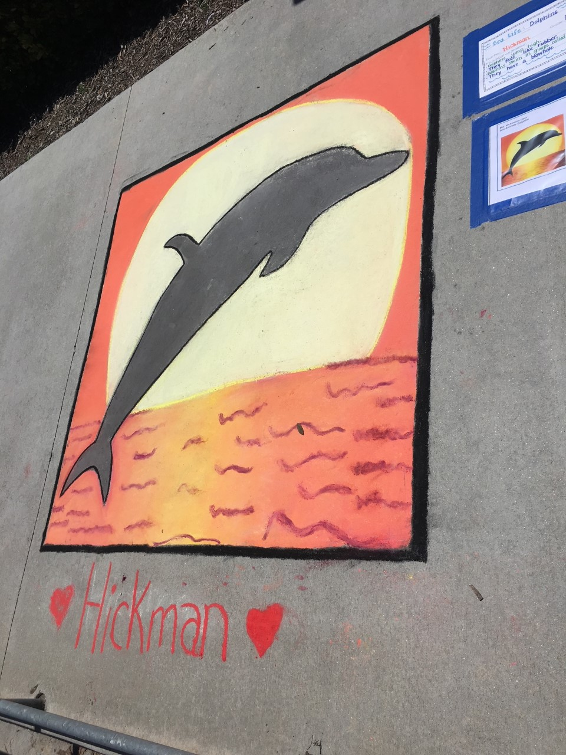

Slide 18


