Slide 1



Slide 2
What is Reflections?
The Reflections Art Program has been bringing the arts to life for more than 10 million students since 1969. California State PTA and its members, families and kids are on the forefront of this amazing program, which increases community awareness of the importance of arts in education.
Reflections encourages students of all ages to:
Unleash creative talents and be inspired
Express themselves imaginatively in their artwork
Experience the fun and joy of making art
Tap into critical thinking skills to create art inspired by the annual theme
Receive positive recognition for their original works of art.

Slide 3
PTA Reflections is a program offered at wolf canyon (it is similar to an art contest)
SELECTED ART WORK WILL MOVE ONTO CHULA VISTA COUNCIL PTA (THIS IS THE NEXT LEVEL OF PTA REFLECTIONS judging)
PRIZES ARE AWARDED TO STUDETS MOVING UP TO CHULA VISTA COUNCIL
ART WORK WILL BE DISPLAYED IN THE SCHOOL LIBRARY
ALL ENTIRES WILL BE JUDGED "BLINDLY" (EACH ENTRY WILL BE ASSIGNED A NUMBER-PLEASE WRITE YOUR NAME ON THE BACK OF YOUR ENTRY)
WINNERS BE BE ANNOUNCED AT THE FRIDAY BLACKTOP ASSEMBLY (NOV. 3RD)

Slide 4
THEME. MATTERS.
-ALL ENTRIES MUST BE NEW. THEY MAY NOT BE PROJECTS CREATED FOR OTHER CONTESTS.
-THis year's theme is, I am hopeful because...
-SUBMISSIONS MUST BE CREATED WITH THE THEME IN MIND. STUDENTS SHOULD USE THEME STATEMENT TO EXPRESS HOW THIS WAS DONE.

Slide 5
Visit The art blog
https://wolfpackartistsblog.wordpress.com/ Or go the Wolf Canyon Blog and Click on Art program
You will find all student forms on the Art Blog Or stop by Room 703 to get paper forms from Mrs. Adamos
E-mail questions to Mrs. Adamos: Joanne.Adamos@cvesd.org
All entries are due to Mrs. Adamos by Friday, October 20th . No late entries accepted.
Judging will take place On October 23rd-27th.
Blacktop celebration to announce winners (Nov. 3rd)

Slide 6
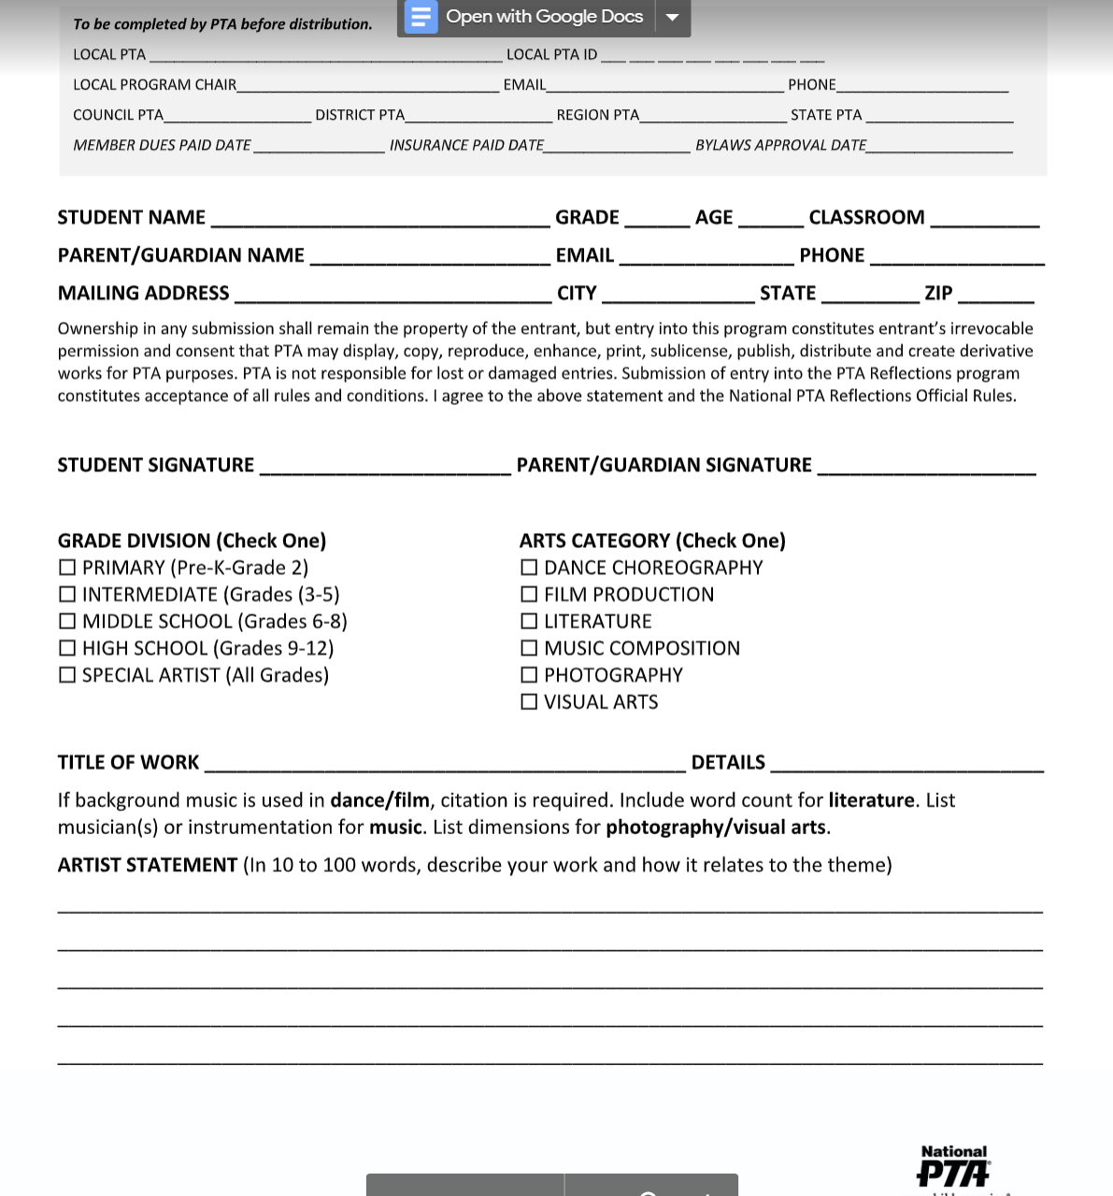
Student form
Very important: Worth up to 40 pts.

Slide 7
Catergories offered at Wolf Canyon:
Visual Arts
Photography
Special Artist
Literature

Slide 8
DUE DATES
Student entries AND form are due October 20th
Make sure to read guidelines! Any submissions that do not meet the guidleines will be returned.

Slide 9
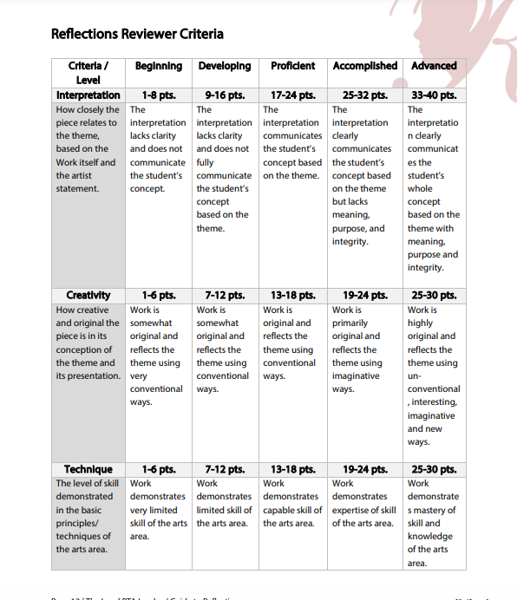
How your entry will be judged!

Slide 10
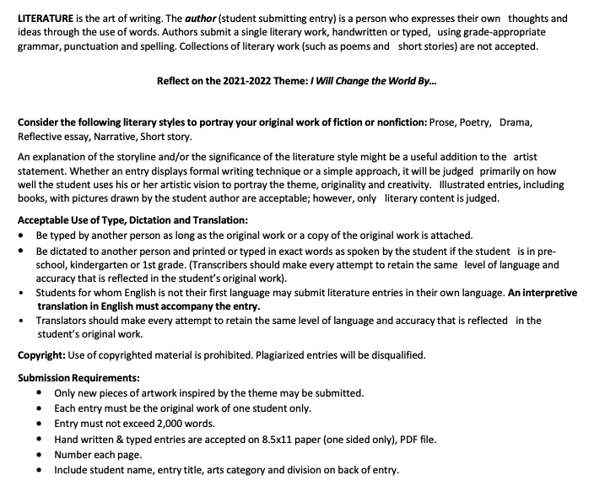
Literature

Slide 11

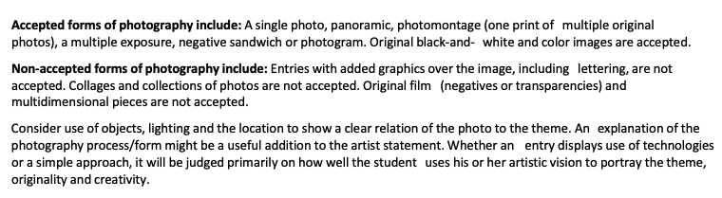
Photography

Slide 12
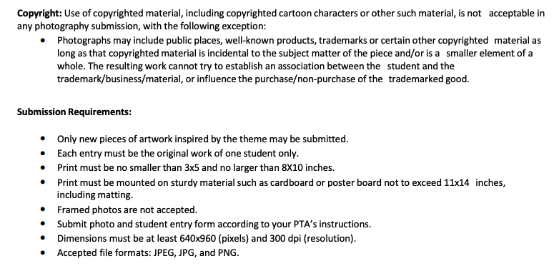

Slide 13
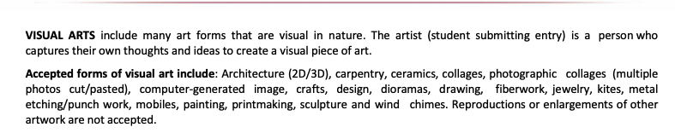

Visual Arts

Slide 14
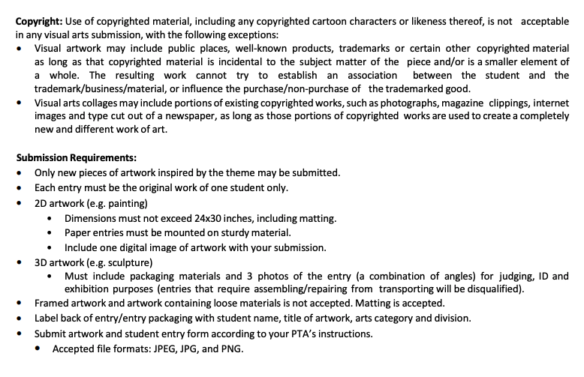

Slide 15
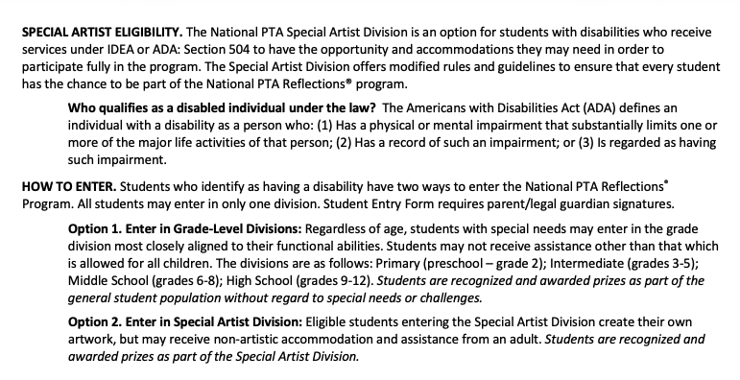
Special Artist

Slide 16
